Slide 1
SPIMI Project
Eve Raya
40016485

Slide 2
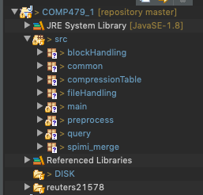
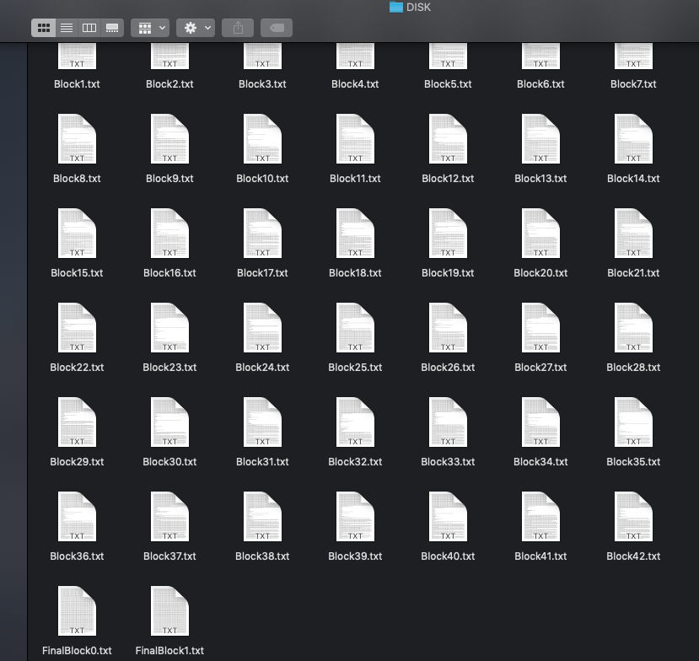
SRC and DISK Structure

Slide 3
Packages, methods, and files
BlockHandling (pckg):
addToBlock(String token, String docID)
getBlock(String blockName)
FileHandling (pckg):
sendToBlock(int blockNumber):
sendToFinalFile(TreeMap sortedList, int final_file_number):
DeleteFiles():
Common (pckg)
Getters and setter for the SortedDictionnary using a TreeMap<String, LikedHashSet<String>>
Getters and setters for the PostingList using LinkedHashSet<String>
Getters and setters for the Dictionnary using HashMap<String, LinkedHashSet<String>>
CompressionTable (pckg):
noNumber:
case_fold
stop_words:
percent_numbers_from_unfiltered:
percent_casefolding_from_unfiltered:
percent_stopwords_from_unfiltered:
percent_previous_numbers:
percent_previous_case_folding:
percent_previous_stopwords:
printTable():
Preprocess (pckg):
ArrayList<String>
Stopwords:
Remove_stopwords(String token):
Remove_numbers(String token):
Case_folding(String token):
Punctuation(String token):
Query(pckg):
searchTerm(String query):
searchDictionary(String query):
CustomAndQuery(String query):
CustomORQuery(String query):
intersection(List<String> list1, List<String> list2):
union(List<String> result,
LinkedHashSet<String> linkedHashSet):
printQueries():
Spimi_merge (pckg):
Merge(int nbrOfBlocks):
Main (pckg):
The main.java runs the program by calling all previous functions. It starts by running the the reuters files and parsing them, tokenizing them and sending them to blocks. Then these blocks are merged, sorted and sent to final files. A query search term is done at the end and a compression table is printed.
DISK (Folder):
This folder contains all of the different blocks created when storing the terms in the dictionary. There are currently 42 blocks created, in which each block has terms from 500 different documents. This folder also includes the FinalBlock file, which has all of the terms merged from all 42 blocks, which are sorted by their keys in alphabetical order.
Reuters21578(Folder):
This folder contains the reuters files from which the SPIMI inverted index is created

Slide 4
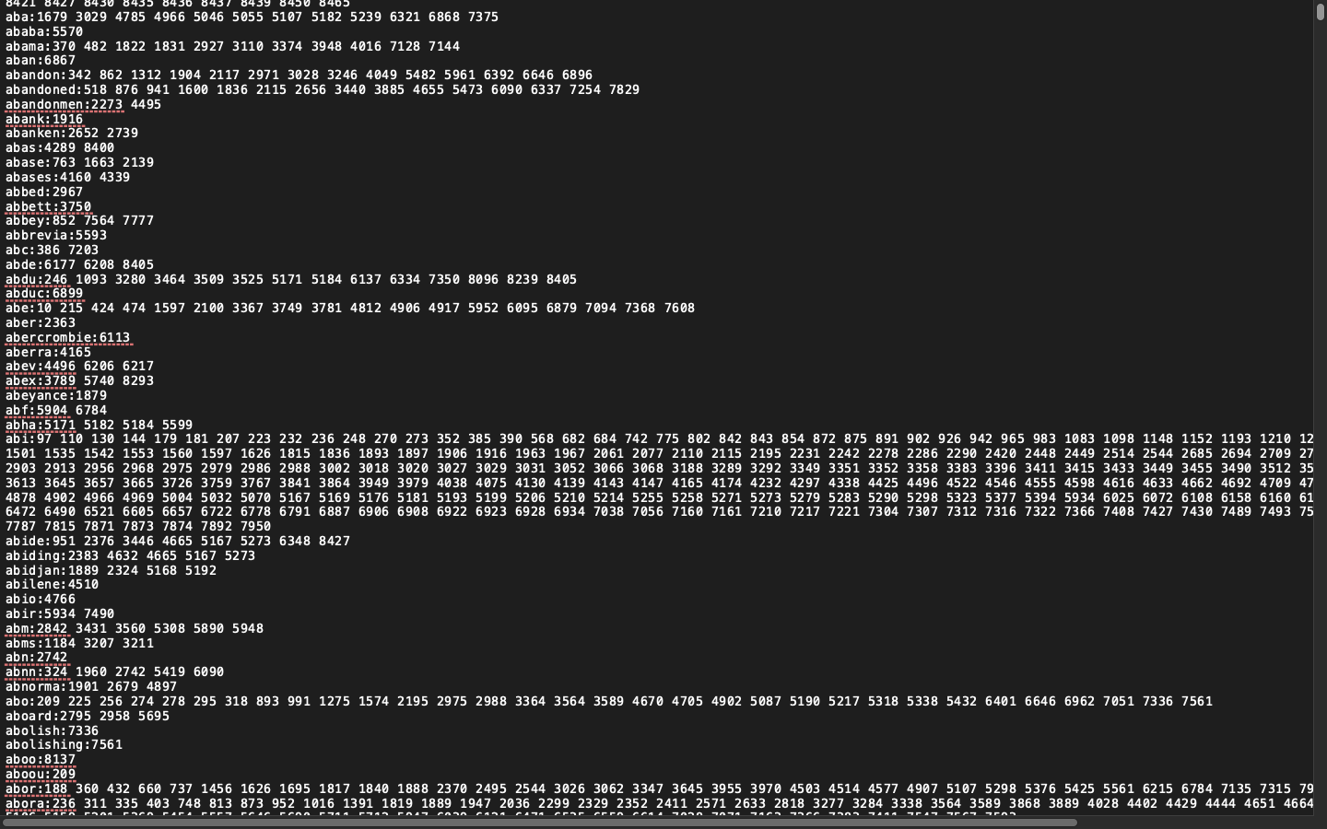
Final Block File example

Slide 5
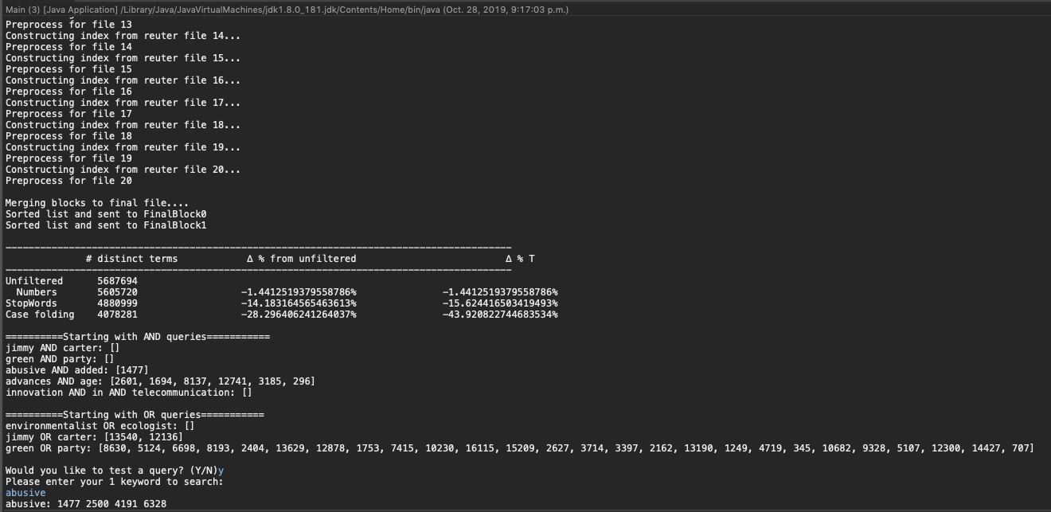
Program running

